Slide 1

CHAPTER 8
PROPERTIES OF RELATIONS
Copyright © Cengage Learning. All rights reserved.

Slide 2

8.5
Partial Order Relations
Copyright © Cengage Learning. All rights reserved.

Slide 3
Antisymmetry

Slide 4
Antisymmetry
In earlier section, we have defined three properties of relations: reflexivity, symmetry, and transitivity. A fourth property of relations is called antisymmetry.
In terms of the arrow diagram of a relation, saying that a relation is antisymmetric is the same as saying that whenever there is an arrow going from one element to another distinct element, there is not an arrow going back from the second to the first.

Slide 5
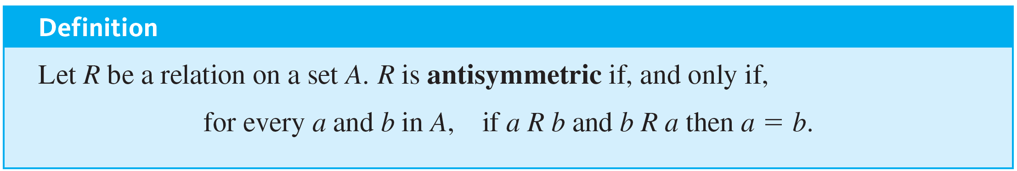
Antisymmetry
By taking the negation of the definition, you can see that a relation R is not antisymmetric if, and only if,
there are elements a and b in A such that a R b and b R a but a ≠ b.

Slide 6
Example 8.5.1 – Testing for Antisymmetry of Finite Relations
Let R₁ and R₂ be the relations on {0, 1, 2} defined as follows: Draw the directed graphs for R₁ and R₂ and indicate which relations are antisymmetric.
a. R₁ = {(0, 2), (1, 2), (2, 0)}
b. R₂ = {(0, 0), (0, 1), (0, 2), (1, 1), (1, 2)}

Slide 7
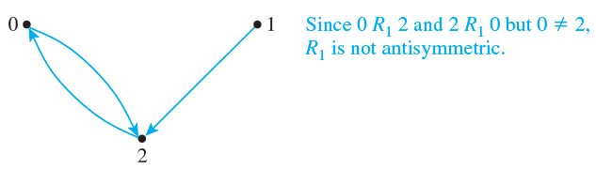
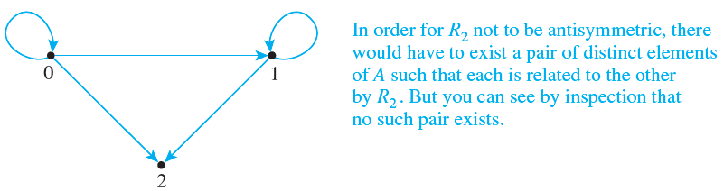
Example 8.5.1 – Solution
a. R₁ is not antisymmetric.
b. R₂ is antisymmetric.

Slide 8
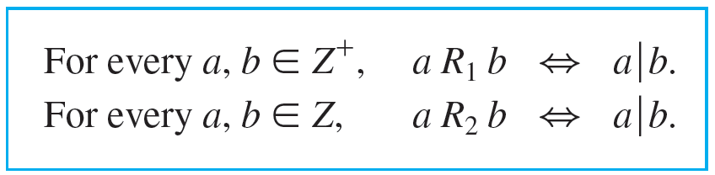
Example 8.5.2 – Testing for Antisymmetry of “Divides” Relations
Let R₁ be the “divides” relation on the set of all positive integers, and let R₂ be the “divides” relation on the set of all integers.
a. Is R₁ antisymmetric? Prove or give a counterexample.
b. Is R₂ antisymmetric? Prove or give a counterexample.

Slide 9

Example 8.5.2 – Solution
a. R₁ is antisymmetric.
Proof: Suppose a and b are positive integers such that a R₁ b and b R₁ a. [We must show that a = b.] By definition of R₁,
Thus, by definition of divides, there are integers k₁ and k₂ with b = k₁a and a = k₂b. It follows that
b = k₁a = k₁(k₂b) = (k₁k₂)b.
Dividing both sides by b gives
k₁k₂ = 1.

Slide 10


Example 8.5.2 – Solution
continued
Now since a and b are both integers, k₁ and k₂ are both positive integers also. And the only product of two positive integers that equals 1 is 1 · 1. Thus
k₁ = k₂ = 1
and so a = k₂b = 1 · b = b.
b. R₂ is not antisymmetric.
Counterexample:
Let a = 2 and b = −2. Then
[since −2 = (−1) · 2] and
[since 2 = (−1)(−2)]. Hence a R₂ b and b R₂ a but a ≠ b.

Slide 11
Partial Order Relations

Slide 12
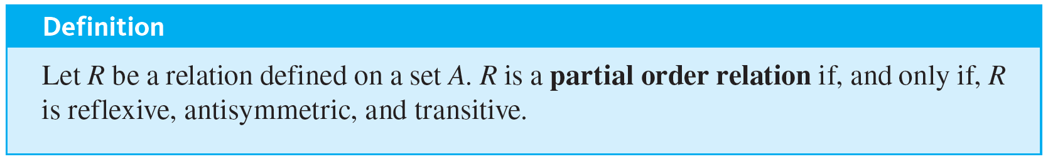
Partial Order Relations
A relation that is reflexive, antisymmetric, and transitive is called a partial order.
Two fundamental partial order relations are the “less than or equal to” relation on a set of real numbers and the “subset” relation on a set of sets. These can be thought of as models, or paradigms, for general partial order relations.

Slide 13

Example 8.5.3 – The “Subset” Relation
Let
be any collection of sets and define the “subset” relation, ⊆, on
as follows: For every U, V ∈
We know that ⊆ is reflexive and transitive. Finish the proof that ⊆ is a partial order relation by proving that ⊆ is antisymmetric.

Slide 14
Example 8.5.3 – Solution
For ⊆ to be antisymmetric means that for all sets U and V in
, if U ⊆ V and V ⊆ U then U = V. This is true by definition of equality of sets.

Slide 15

Example 8.5.4 – A “Divides” Relation on a Set of Positive Integers
Let
be the “divides” relation on a set A of positive integers. That is, for all a and b in A,
Prove that
is a partial order relation on A.

Slide 16




Example 8.5.4 – Solution
]
Suppose a ∈ A. Then a = 1 · a, so
is reflexive: [We must show that for each a ∈ A,
by definition of divisibility.
is antisymmetric: [We must show that for every a, b ∈ A, if
then a = b.] The proof of this is virtually identical to that of Example 8.5.2(a).
is transitive: To show transitivity means to show that for every a, b, c ∈ A, if
and

Slide 17
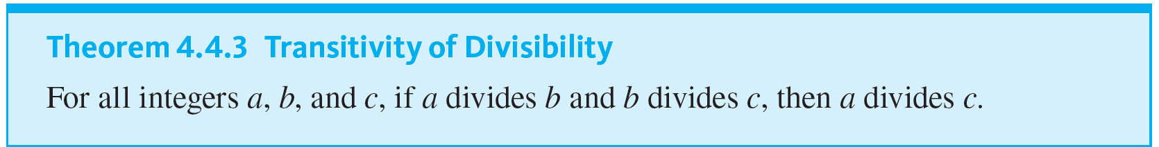
Example 8.5.4 – Solution
continued
But this is the transitivity of divisibility property, which was proved as Theorem 4.4.3.
Since
is reflexive, antisymmetric, and transitive,
is a partial order relation on A.

Slide 18

Example 8.5.5 – The “Less Than or Equal to” Relation
Let S be a set of real numbers and define the “less than or equal to” relation, ≤, on S as follows: For all real numbers x and y in S,
Show that ≤ is a partial order relation.

Slide 19
Example 8.5.5 – Solution
≤ is reflexive: For ≤ to be reflexive means that x ≤ x for every real number x in S. But x ≤ x means that x < x or x = x, and x = x is always true.
≤ is antisymmetric: For ≤ to be antisymmetric means that for all real numbers x and y in S, if x ≤ y and y ≤ x then x = y. This follows immediately from the definition of ≤ and the trichotomy property, which says that given any real numbers x and y, exactly one of the following holds: x < y or x = y or x > y.

Slide 20
Example 8.5.5 – Solution
continued
≤ is transitive: For ≤ to be transitive means that for all real numbers x, y, and z in S if x ≤ y and y ≤ z then x ≤ z.
This follows from the definition of ≤ and the transitivity property of order, which says that given any real numbers x, y, and z, if x < y and y < z then x < z.
Because ≤ is reflexive, antisymmetric, and transitive, it is a partial order relation.

Slide 21
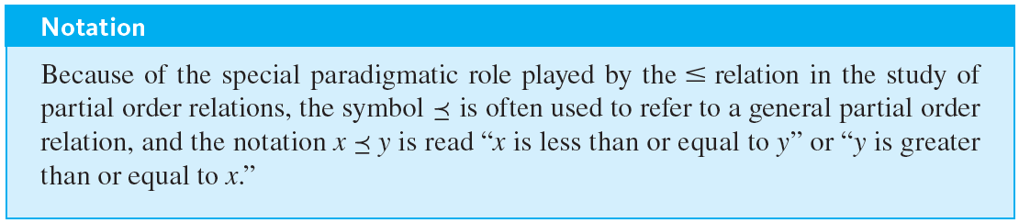
Partial Order Relations

Slide 22
Lexicographic Order

Slide 23
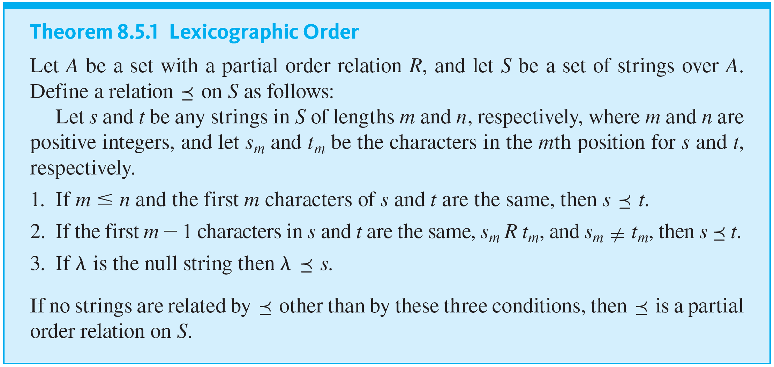
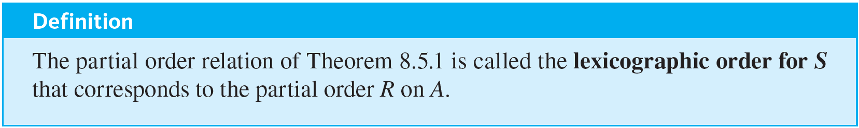
Lexicographic Order

Slide 24
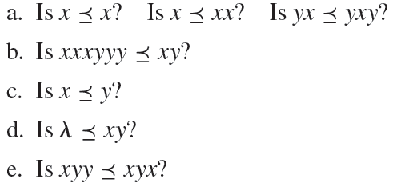
Example 8.5.6 – Testing Strings for Lexicographic Order
Let A = {x, y} and let R be the following partial order relation on A: R = {(x, x), (x, y), (y, y)}.
Let S be the set of all strings over A, and denote by the lexicographic order for S that corresponds to R.

Slide 25
Example 8.5.6 – Solution
a. Yes in all three cases, by property (1) of the definition of
b. Yes in all cases, by property (2) of the definition of
c. Yes in all cases, by property (2) of the definition of
In this case m − 1 = 0, and the statement that the first zero characters of x and y are the same is true by default.
d. Yes by property (3) of the definition of
e. No because y is not related to x by R.

Slide 26
Hasse Diagrams

Slide 27

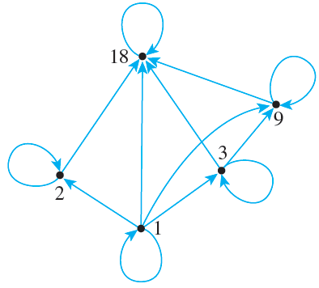
Hasse Diagrams
Let A = {1, 2, 3, 9, 18} and consider the “divides” relation on A: For every a, b ∈ A,
The directed graph of this relation has the following appearance:

Slide 28
Hasse Diagrams
Note that there is a loop at every vertex, all other arrows point in the same direction (upward), and any time there is an arrow from one point to a second and from the second point to a third, there is an arrow from the first point to the third.
Given any partial order relation defined on a finite set, it is possible to draw the directed graph in such a way that all of these properties are satisfied.

Slide 29
Hasse Diagrams
This makes it possible to associate a somewhat simpler graph, called a Hasse diagram (after Helmut Hasse, a twentieth-century German number theorist), with a partial order relation defined on a finite set.
To obtain a Hasse diagram, proceed as follows: Start with a directed graph of the relation, placing vertices on the page so that all arrows point upward.

Slide 30
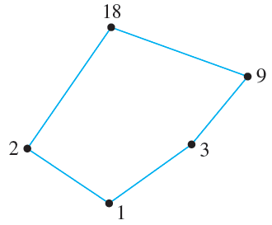
Hasse Diagrams
Then eliminate
1. the loops at all the vertices,
2. all arrows whose existence is implied by the transitive property, and
3. the direction indicators on the arrows.
For the relation given previously, the Hasse diagram is as follows:

Slide 31



Example 8.5.7 – Constructing a Hasse Diagram
Consider the “subset” relation, ⊆, on the set
That is, for all sets U and V in
Construct the Hasse diagram for this relation.

Slide 32
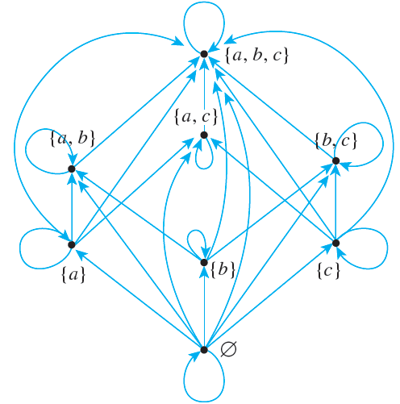
Example 8.5.7 – Solution
Draw the directed graph of the relation in such a way that all arrows except loops point upward.

Slide 33
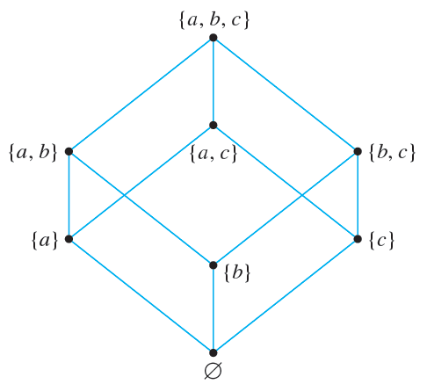
Example 8.5.7 – Solution
continued
Then strip away all loops, unnecessary arrows, and direction indicators to obtain the Hasse diagram.

Slide 34
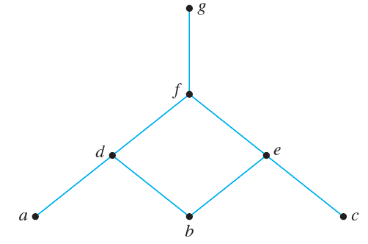
Example 8.5.8 – Obtaining the Directed Graph of a Partial Order Relation from the Hasse Diagram of the Relation
A partial order relation R has the following Hasse diagram. Find the directed graph of R.

Slide 35
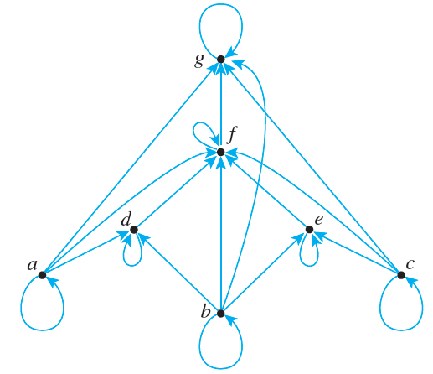
Example 8.5.8 – Solution

Slide 36
Partially and Totally Ordered Sets

Slide 37
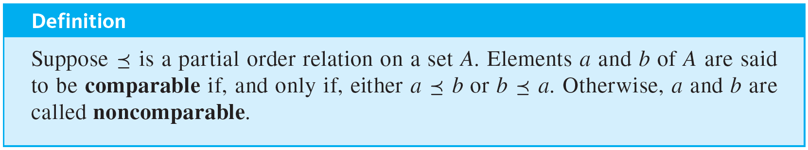
Partially and Totally Ordered Sets
Given any two real numbers x and y, either x ≤ y or y ≤ x. In a situation like this, the elements x and y are said to be comparable. On the other hand, given two subsets A and B of {a, b, c}, it may be the case that neither A ⊆ B nor B ⊆ A. For instance, let A = {a, b} and B = {b, c}. Then A ⊈ B and B ⊈ A. In such a case, A and B are said to be noncomparable.

Slide 38
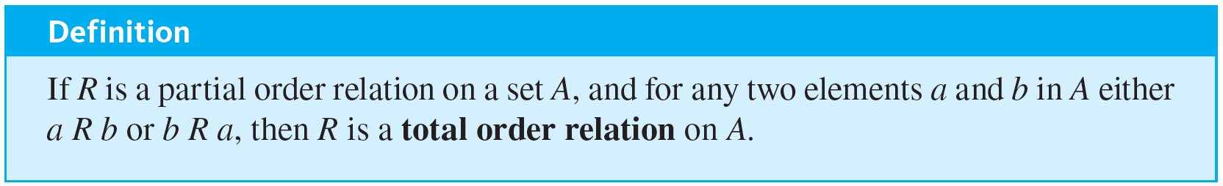
Partially and Totally Ordered Sets
When all the elements of a partial order relation are comparable, the relation is called a total order.
Both the “less than or equal to” relation on sets of real numbers and the lexicographic order of the set of words in a dictionary are total order relations. Note that the Hasse diagram for a total order relation can be drawn as a single vertical “chain.”

Slide 39
Partially and Totally Ordered Sets
A set A is called a partially ordered set (or poset) with respect to a relation
if, and only if,
is a partial order relation on A.
For instance, the set of real numbers is a partially ordered set with respect to the “less than or equal to” relation ≤, and a set of sets is partially ordered with respect to the “subset” relation ⊆.
It is entirely straightforward to show that any subset of a partially ordered set is partially ordered.

Slide 40
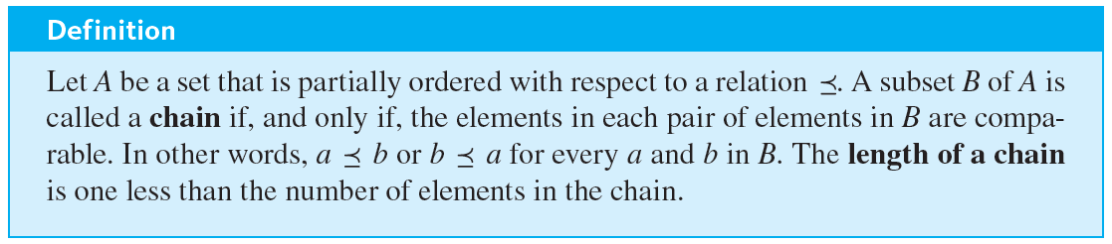
Partially and Totally Ordered Sets
This, of course, assumes the “same definition” for the relation on the subset as for the set as a whole. A set A is called a totally ordered set with respect to a relation
if, and only if, A is partially ordered with respect to
is a total order. A set that is partially ordered but not totally ordered may have totally ordered subsets. Such subsets are called chains.

Slide 41


Example 8.5.9 – A Chain of Subsets
The set
is partially ordered with respect to the subset relation. Find a chain of length 3 in

Slide 42

Example 8.5.9 – Solution
Since
is a chain of length 3 in

Slide 43
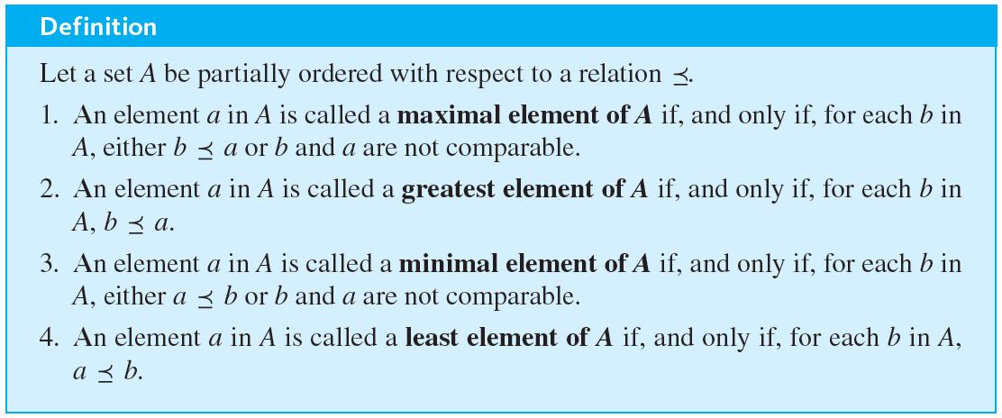
Partially and Totally Ordered Sets
A maximal element in a partially ordered set is an element that is greater than or equal to every element to which it is comparable. A greatest element in a partially ordered set is an element that is greater than or equal to every element in the set. Minimal and least elements are defined similarly.

Slide 44
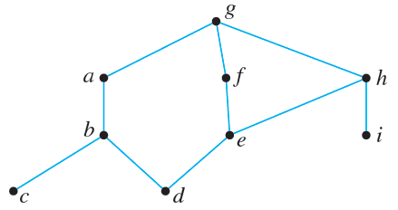
Example 8.5.10 – Maximal, Minimal, Greatest, and Least Elements
Let A = {a, b, c, d, e, f, g, h, i } have the partial ordering
defined by the following Hasse diagram.
Find all maximal, minimal, greatest, and least elements of A.

Slide 45
Example 8.5.10 – Solution
There is just one maximal element, g, which is also the greatest element. The minimal elements are c, d, and i, and there is no least element.

Slide 46
Topological Sorting

Slide 47
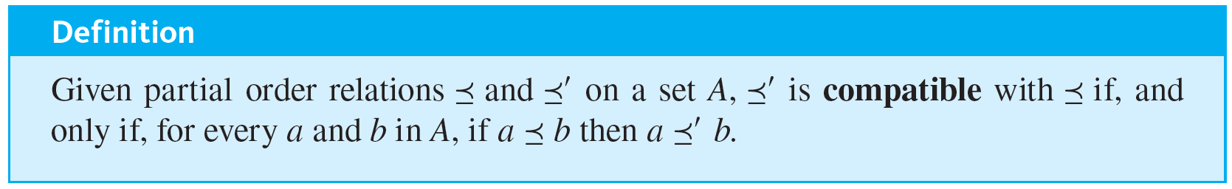
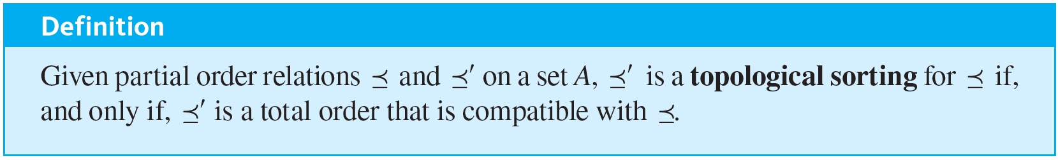
Topological Sorting
A total order that is compatible with a given order is called a topological sorting.

Slide 48
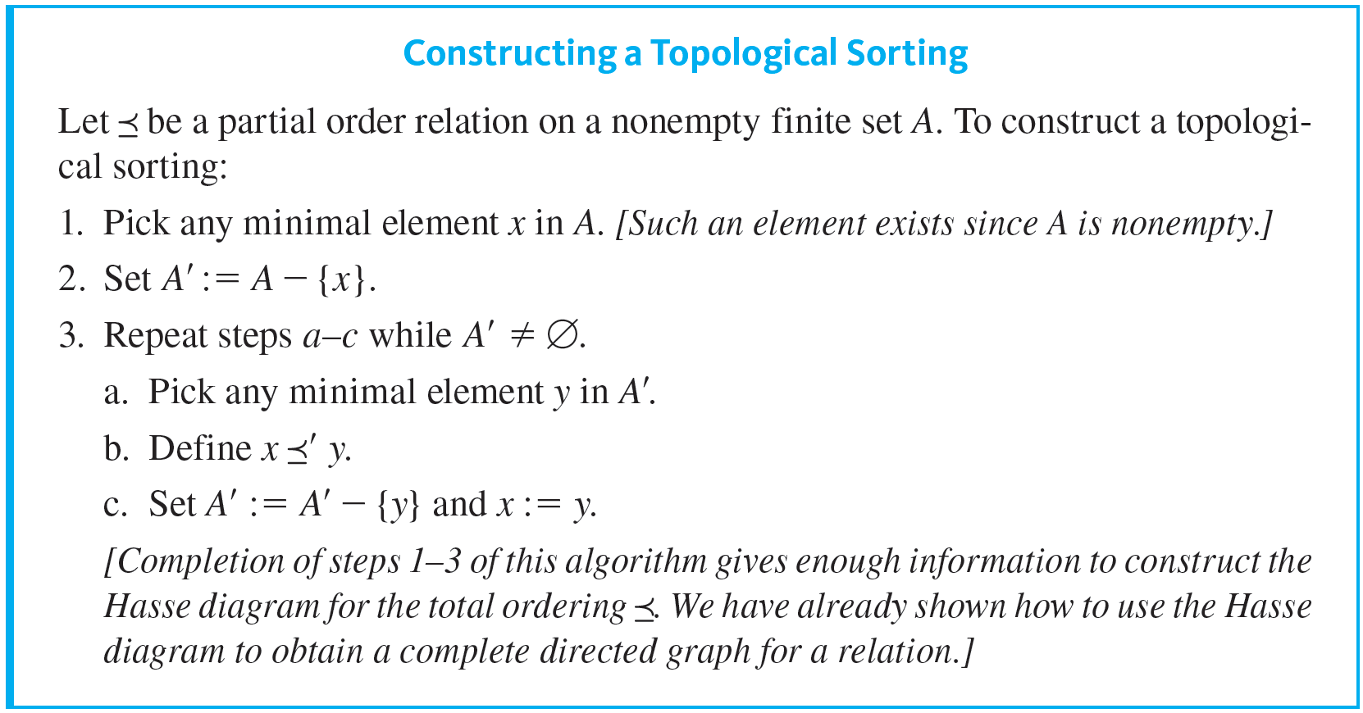
Topological Sorting
Here is a formal version of the algorithm:

Slide 49
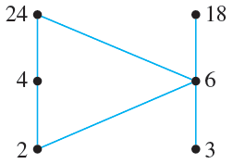

Example 8.5.11 – A Topological Sorting
Consider the set A = {2, 3, 4, 6, 18, 24} ordered by the “divides” relation
The Hasse diagram of this relation is the following:
The ordinary “less than or equal to” relation ≤ on this set is a topological sorting for it since for positive integers a and b, if
then a ≤ b. Find another topological sorting for this set.

Slide 50
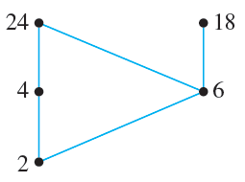
Example 8.5.11 – Solution
The set has two minimal elements: 2 and 3. Either one may be chosen; suppose you pick 3. The beginning of the total order is
total order: 3.
Set A′ = A − {3}. You can indicate this by removing 3 from the Hasse diagram as shown below.

Slide 51

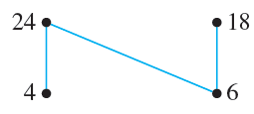
Example 8.5.11 – Solution
continued
Next choose a minimal element from A′ − {3}. Only 2 is minimal, so you must pick it. The total order thus far is
Set A′ = (A − {3}) − {2} = A − {3, 2}. You can indicate this by removing 2 from the Hasse diagram, as is shown below.
Choose a minimal element from A′ − {3, 2}. Again you have two choices: 4 and 6. Suppose you pick 6.

Slide 52



Example 8.5.11 – Solution
continued
The total order for the elements chosen thus far is
You continue in this way until every element of A has been picked. One possible sequence of choices gives
You can verify that this order is compatible with the “divides” partial order by checking that for each pair of elements a and b in A such that
Note that it is not the case that if

Slide 53
An Application

Slide 54
An Application
Note that the following defines a partial order relation on the set of courses required for a university degree:
For all required courses x and y,
If the Hasse diagram for the relation is drawn, then the questions raised at the beginning of this section can be answered easily.

Slide 55
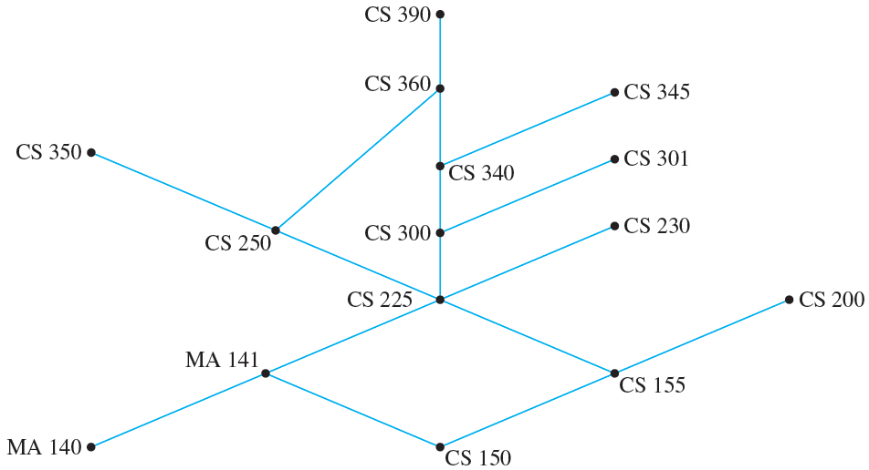
An Application
For instance, consider the Hasse diagram for the requirements at a particular university, which is shown in Figure 8.5.1.
Figure 8.5.1

Slide 56
An Application
The minimum number of school terms needed to complete the requirements is the size of a longest chain, which is 7 (150, 155, 225, 300, 340, 360, 390, for example).
The maximum number of courses that could be taken in the same term (assuming the university allows it) is the maximum number of noncomparable courses, which is 6 (350, 360, 345, 301, 230, 200, for example).

Slide 57
An Application
A part-time student could take the courses in a sequence determined by constructing a topological sorting for the set. (One such sorting is 140, 150, 141, 155, 200, 225, 230, 300, 250, 301, 340, 345, 350, 360, 390. There are many others.)

Slide 58
PERT and CPM

Slide 59
PERT and CPM
Two important and widely used applications of partial order relations are PERT (Program Evaluation and Review Technique) and CPM (Critical Path Method).
These techniques were developed in the 1950s as planners came to grips with the complexities of scheduling the individual activities needed to complete very large projects, and although they are very similar, their developments were independent.

Slide 60
PERT and CPM
PERT was developed by the U.S. Navy to help organize the construction of the Polaris submarine, and CPM was developed by the E. I. Du Pont de Nemours company for scheduling chemical plant maintenance.
Here is a somewhat simplified example of the way the techniques work.

Slide 61
Example 8.5.12 – A Job Scheduling Problem
At an automobile assembly plant, the job of assembling an automobile can be broken down into these tasks:
1. Build frame.
2. Install engine, power train components, gas tank.
3. Install brakes, wheels, tires.
4. Install dashboard, floor, seats.
5. Install electrical lines.
6. Install gas lines.

Slide 62
Example 8.5.12 – A Job Scheduling Problem
continued
7. Install brake lines.
8. Attach body panels to frame.
9. Paint body.
Certain of these tasks can be carried out at the same time, whereas some cannot be started until other tasks are finished.

Slide 63
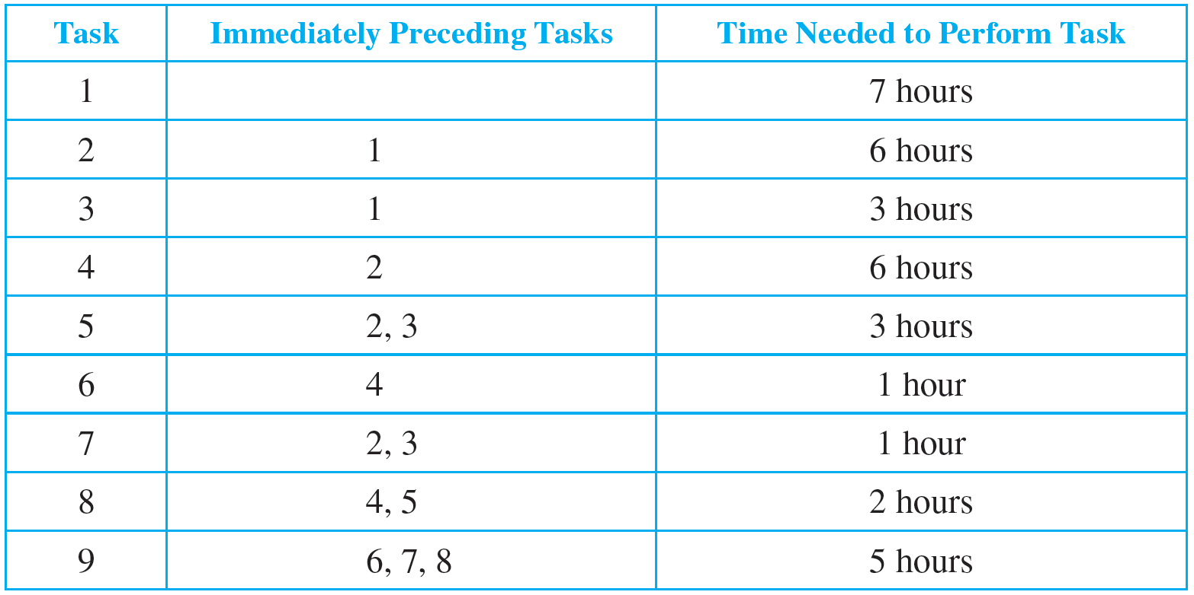
Example 8.5.12 – A Job Scheduling Problem
continued
Table 8.5.1 summarizes the order in which tasks can be performed and the time required to perform each task.
Table 8.5.1

Slide 64

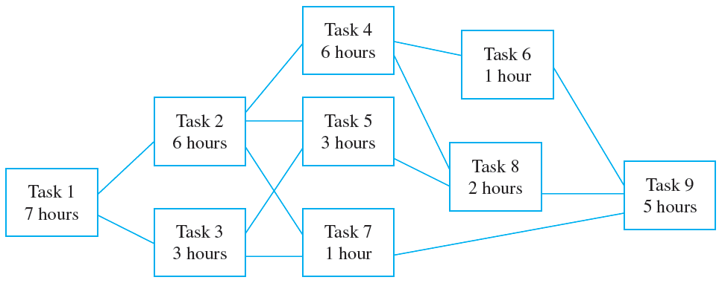
Example 8.5.12 – A Job Scheduling Problem
continued
Let T be the set of all tasks, and consider the partial order relation
defined on T as follows: For all tasks x and y in T,
If the Hasse diagram of this relation is turned sideways (as is customary in PERT and CPM analysis), it has the appearance shown on the right side.

Slide 65
Example 8.5.12 – A Job Scheduling Problem
continued
What is the minimum time required to assemble a car? You can determine this by working from left to right across the diagram, noting for each task (say, just above the box representing that task) the minimum time needed to complete that task starting from the beginning of the assembly process.
For instance, you can put a 7 above the box for task 1 because task 1 requires 7 hours.

Slide 66
Example 8.5.12 – A Job Scheduling Problem
continued
Task 2 requires completion of task 1 (7 hours) plus 6 hours for itself, so the minimum time required to complete task 2, starting at the beginning of the assembly process, is 7 + 6 = 13 hours.
So you can put a 13 above the box for task 2. Similarly, you can put a 10 above the box for task 3 because 7 + 3 = 10.
Now consider what number you should write above the box for task 5.

Slide 67
Example 8.5.12 – A Job Scheduling Problem
continued
The minimum times to complete tasks 2 and 3, starting from the beginning of the assembly process, are 13 and 10 hours respectively.
Since both tasks must be completed before task 5 can be started, the minimum time to complete task 5, starting from the beginning, is the time needed for task 5 itself (3 hours) plus the maximum of the times to complete tasks 2 and 3 (13 hours), and this equals 3 + 13 = 16 hours.
Thus you should place the number 16 above the box for task 5.

Slide 68
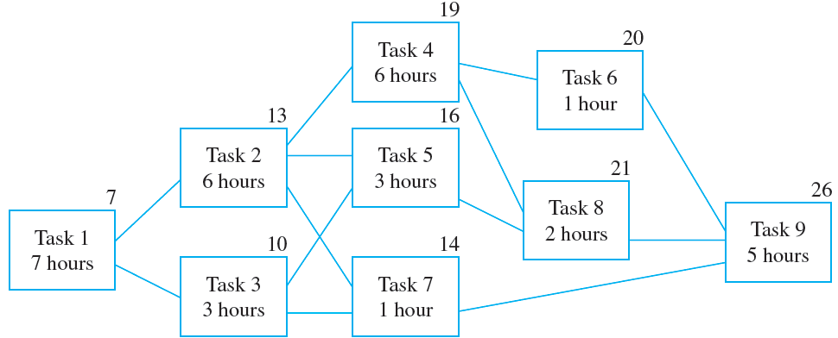
Example 8.5.12 – A Job Scheduling Problem
continued
The same reasoning leads you to place a 14 above the box for task 7. Similarly, you can place a 19 above the box for task 4, a 20 above the box for task 6, a 21 above the box for task 8, and a 26 above the box for task 9, as shown below.

Slide 69
Example 8.5.12 – A Job Scheduling Problem
continued
This analysis shows that at least 26 hours are required to complete task 9 starting from the beginning of the assembly process.
When task 9 is finished, the assembly is complete, so 26 hours is the minimum time needed to accomplish the whole process.
Note that the minimum time required to complete tasks 1, 2, 4, 8, and 9 in sequence is exactly 26 hours.

Slide 70
Example 8.5.12 – A Job Scheduling Problem
continued
This means that a delay in performing any one of these tasks causes a delay in the total time required for assembly of the car.
For this reason, the path through tasks 1, 2, 4, 8, and 9 is called a critical path.

